Slide 1
0.5-11 GHz Analog Fiber-Optic Links for the Allen Telescope Array
Link Design and Component Down-Select
September 12, 2001
Edward Ackerman and Harold Roussell
Edited by JWD 9/19/01
781 272-1819
1

Slide 2
Goal
For a prudent range of link architectures, measure the important RF performance parameters:
  Gain
  Gain flatness (0.5 – 11 GHz)
  Noise figure
  3rd-order distortion-limited dynamic range
  2nd-order distortion-limited dynamic range
  Compression-limited dynamic range
2

Slide 3
Cost of Components in Five Link Approaches
9/10/2001 Price for 1,000
Approach #1: Separate CW Laser and LiNbO₃ MZ Modulator
CW Laser (Excelite
SLT5411-CB-S850)
Mach-Zehnder Modulator
(Codeon Mach-10)
Photodetector (Discovery
DSC50S-3-FC/UPC-K)
Total Link Cost
= $ 4,508
$ 1,013
$ 2,500
$ 995
Approach #2: Separate CW Laser and EA Modulator
CW Laser (Excelite
SLT5411-CB-S850)
Electro-Absorption Modulator
(CyOptics EAM-34)
Photodetector (Discovery
DSC50S-3-FC/UPC-K)
Total Link Cost
= $ 3,608
$ 1,013
$ 1,600
$ 995
Approach #3: Integrated CW Laser and EA Modulator
Externally Modulated DFB Laser
(Fujitsu FLD5F10NP)
Photodetector (Discovery
DSC50S-3-FC/UPC-K)
Total Link Cost
= $ 2,945
$ 1,950
$ 995
Approach #4: Directly Modulated Semiconductor DFB Laser
Directly Modulated DFB Laser
(Agere D1861A)
Photodetector (Discovery
DSC50S-3-FC/UPC-K)
Total Link Cost
= $ 3,240
$ 2,245
$ 995
Approach #5: Directly Modulated Semiconductor VCSEL
Directly Modulated VCSEL
(Emcore 10Gb/s Structure Gen 1)
Photodetector (Discovery
DSC50S-3-FC/UPC-K)
Total Link Cost
< $ 1,995
$ 65 unpackaged
< $ 1,000 packaged
$ 995
3

Slide 4
Forecast for Cost Reduction of Analog Fiber-Optic Link Components*
6000
Empirical data in 1998
5000
Prediction (9/01 to 4/02):
Modulated source cost ↓ 17%
Optical detector cost ↓ 15%
4000
10 Gbps Modulated Source Cost,
10 Gbps Optical Detector Cost
Cheapest available modulated source in January 2002 (demonstrates that prices tend to move in fits in starts)
3000
2000
1000
0
1998
1999
2000
2001
2002
2003
Year
Buy components for prototype link
Buy components for PTA link
*Source: “Technology Roadmap on Microwave Photonics,”
Optoelectronics Industry Development Association, August 2000
4

Slide 5
Cost of Components in Five Link Approaches
Projected 4/1/2002 Price for 1,000
Approach #1: Separate CW Laser and LiNbO₃ MZ Modulator
CW Laser (Excelite
SLT5411-CB-S850)
Mach-Zehnder Modulator
(Codeon Mach-10)
Photodetector (Discovery
DSC50S-3-FC/UPC-K)
Total Link Cost
= $ 3,771
$ 850
$ 2,075
$ 846
Approach #2: Separate CW Laser and EA Modulator
CW Laser (Excelite
SLT5411-CB-S850)
Electro-Absorption Modulator
(CyOptics EAM-34)
Photodetector (Discovery
DSC50S-3-FC/UPC-K)
Total Link Cost
= $ 3,024
$ 850
$ 1,328
$ 846
Approach #3: Integrated CW Laser and EA Modulator
Externally Modulated DFB Laser
(Fujitsu FLD5F10NP)
Photodetector (Discovery
DSC50S-3-FC/UPC-K)
Total Link Cost
= $ 2,464
$ 1,618
$ 846
Approach #4: Directly Modulated Semiconductor DFB Laser
Directly Modulated DFB Laser
(Agere D1861A)
Photodetector (Discovery
DSC50S-3-FC/UPC-K)
Total Link Cost
= $ 2,709
$ 1,863
$ 846
Approach #5: Directly Modulated Semiconductor VCSEL
Directly Modulated VCSEL
(Emcore 10Gb/s Structure Gen 1)
Photodetector (Discovery
DSC50S-3-FC/UPC-K)
Total Link Cost
< $ 1,846
$ 65 unpackaged
< $ 1,000 packaged
$ 846
5

Slide 6
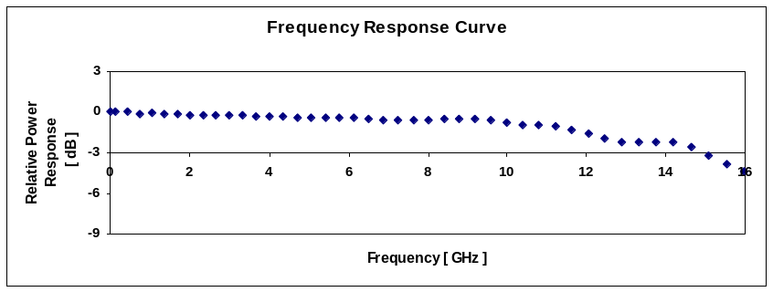
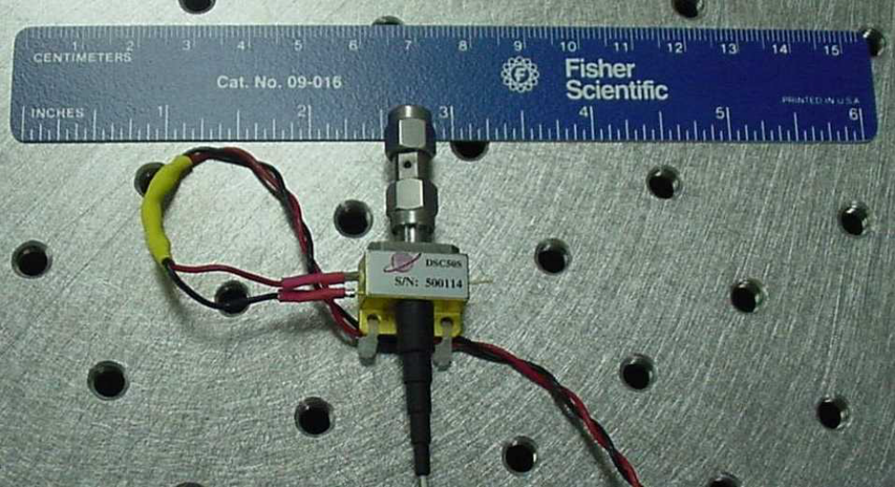

Photodetector Performance
Discovery Semiconductor DSC50S-3-FC/UPC-K
The same Discovery Semiconductor photodetector was used in all link demonstrations. We purchased and characterized two:
3 dB Bandwidth = 14.75 GHz
Response at 11 GHz: ~ –1 dB
3 dB Bandwidth = 15 GHz
Response at 11 GHz: ~ –1 dB
6

Slide 7
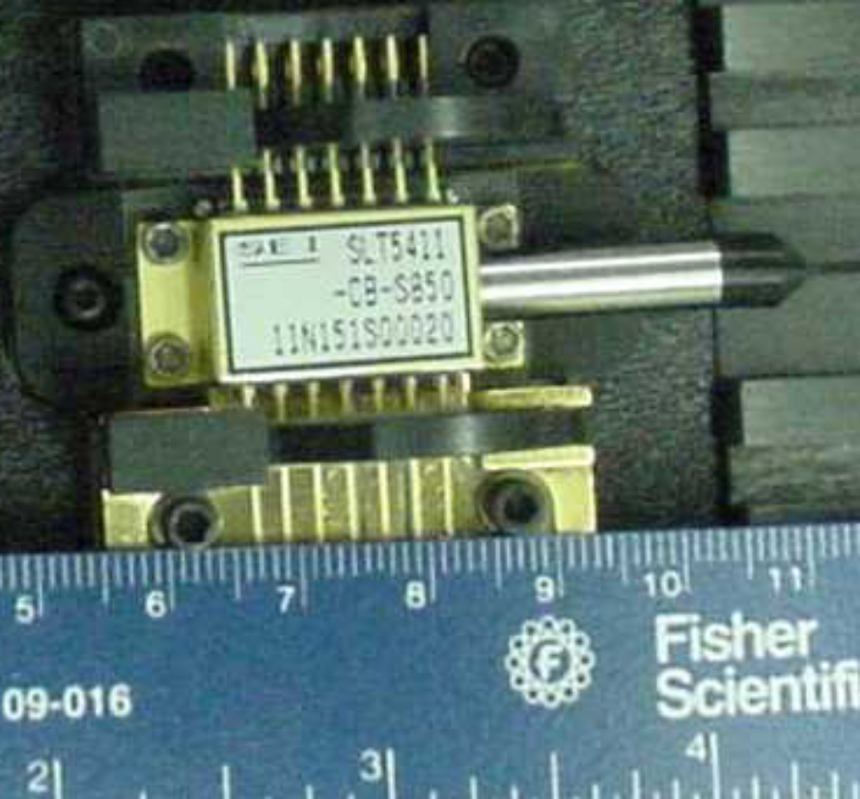
Approach #1: LiNbO₃ MZ Modulator
Test Configuration (Room Temperature)
I_{TEC} = 4 mA
I_{laser} = 75 mA
Optical loss
≅ .12 dB
Optical loss
≅ 1.12 dB
Excelight
Laser
Codeon
Modulator
Discovery
Photodiode
PM fiber
1 km
SM fiber spool
P_{laser} = 20 mW
λ_{laser} = 1510 nm
Bias
Tee
RF Input Port
V_{M}
(DC)
V_{bias} = 6 V
I_{det} = 3.72 mA
RF Output Port
(Photo removed)
Single-mode and polarization-maintaining fiber connections were achieved using FC/PC connectors.
7

Slide 8
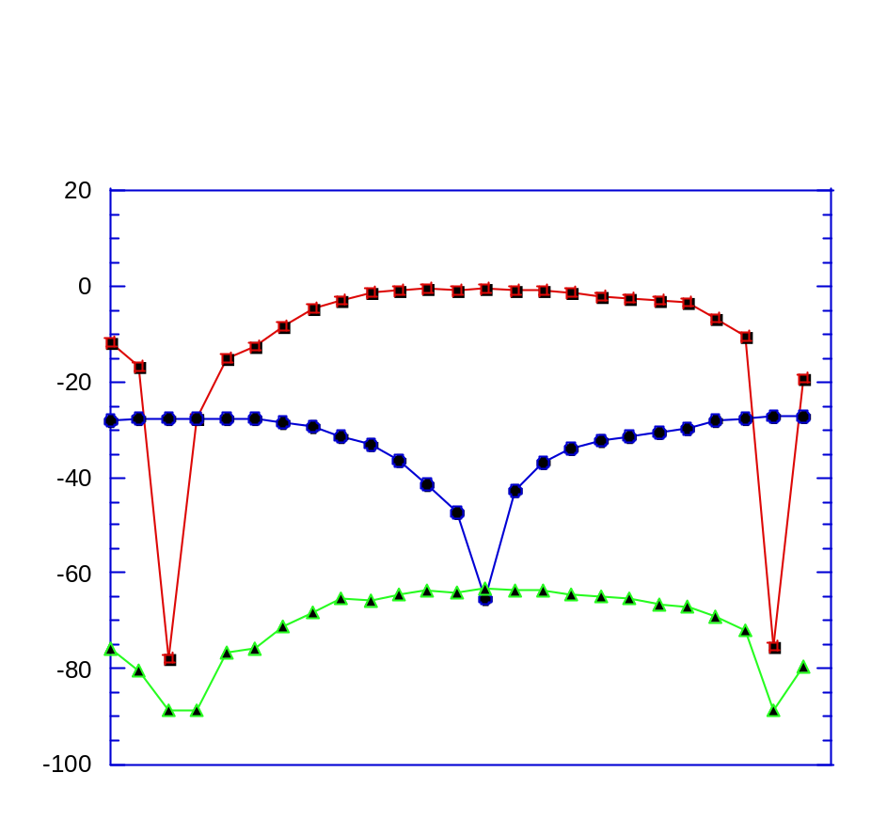
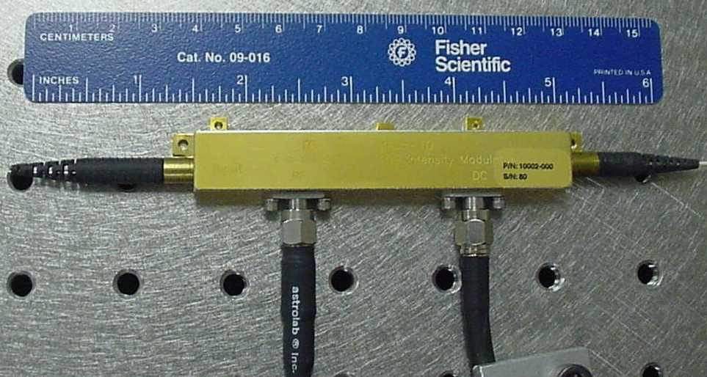
Approach #1: LiNbO₃ MZ Modulator
Measured Signal and Distortion Characteristics vs. DC Bias Voltage
Optimum bias voltage
(2nd-order distortion
is minimized)
f₁ = 5 GHz
2f₁ = 10 GHz
Relative Signal Magnitude (dB)
3f₁ = 15 GHz
5.75 V
Mach-Zehnder Modulator
(Codeon Mach-10)
DC Bias Voltage (V)
(Input signal: f₁ = 5 GHz)
8

Slide 9
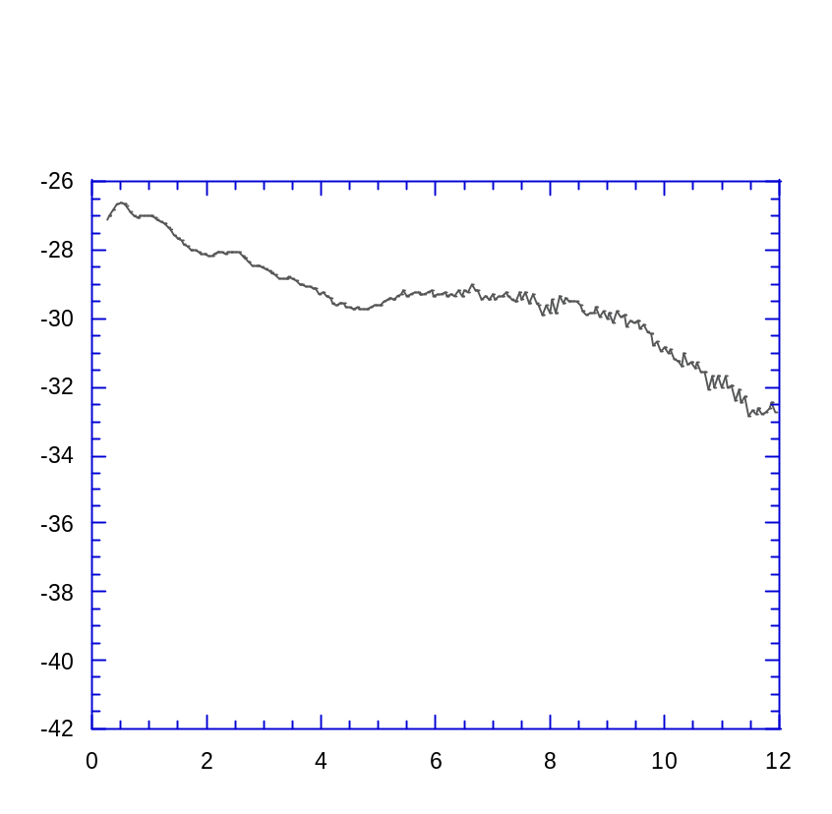

Approach #1: LiNbO₃ MZ Modulator
Measured Performance w/1 km SM fiber and Discovery Photodetector
Measured Link Frequency Response
(Modulator biased for minimum 2nd-order distortion, detector bias = 6 V)
Measured Distortion Products
(Modulator biased for minimum 2nd-order distortion, detector bias = 6 V, fundamental frequencies ~ 5 GHz)
SETI Link: Codeon MZ Modulator & Discovery Detector
-20
3 dB
< 5.5 dB
-40
Fundamental frequencies
-60
Link Gain (dB)
Output Power (dBm)
-80
-100
2nd-order distortion
3rd order distortion
-120
-140
-15
-10
-5
0
5
10
Frequency (GHz)
Input Power at Fundamental (dBm)
Frequency (GHz)
G_{11 GHz} ~ –32 dB
BW_{3dB} > 7.5 GHz
ΔG_{0.5-11 GHz} < 5.5 dB
NF ≤ 39 dB
SFDR₃ ≥ 103 dB·Hz^{2/3} ; SFDR₂ ≥ 93 dB·Hz^{1/2}
CDR ≥ 141 dB·Hz
9

Slide 10
Approach #2: Separate Laser, EA Modulator
Test Configuration (Room Temperature)
I_{TEC} = 10 mA
I_{laser} = 106mA
I_{TEC} = 0 mA
Optical loss
≅ .12 dB
Optical loss
≅ 1.12 dB
JDSU
Laser
Cyoptics
EA modulator
Discovery
Photodiode
P_{laser} = 20 mW
λ_{laser} = 1550 nm
1 km
SM fiber spool
V_{M} = –.75 V
Bias
Tee
Bias
Tee
V_{bias}= 6 V
I_{Det} = 1.76 mA
RF Input
RF Output
Fiber connections were achieved using FC/PC connectors.
JDSU laser was used instead of Excelite laser, because it had a wavelength better suited to the band-edge characteristics of the Cyoptics EA Modulator. The laser had a PM fiber output, which we connected directly to SM fiber input of Cyoptics modulator.
10

Slide 11
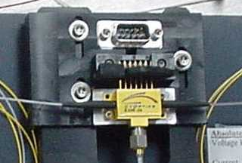
Approach #2: Separate Laser, EA Modulator
Measured Signal and Distortion Characteristics vs. DC Bias Voltage
Optimum bias voltage
(2nd-order distortion
is minimized)
-20
f₁ = 5 GHz
-40
(Photo removed)
-60
Output Signal Magnitude (dBm)
2f₁ = 10 GHz
-80
3f₁ = 15 GHz
-100
Electro-Absorption Modulator
(Cyoptics EAM-34)
-1.4
-1.2
-1
-0.8
-0.6
-0.4
-0.2
DC Bias Voltage (V)
(Input signal: 0 dBm at f₁ = 5 GHz)
11

Slide 12
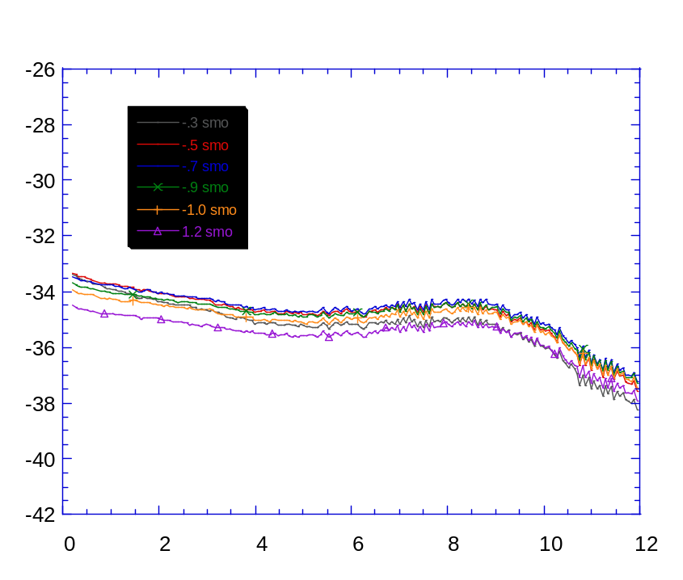
Approach #2: Separate Laser, EA Modulator
Measured Performance w/1 km SM fiber and Discovery Photodetector
Measured Link Frequency Response vs. Modulator Bias Voltage
(Detector bias = 6 V)
Measured Distortion Products
(Modulator biased for minimum 2nd-order distortion, detector bias = 6 V, fundamental frequencies ~ 5 GHz)
-20
-40
Fundamental frequencies
-60
Link Gain (dB)
Output Power (dBm)
3 dB
-80
2nd-order distortion
-100
3rd order distortion
-120
-140
Frequency (GHz)
-15
-10
-5
0
5
10
Input Power at Fundamental (dBm)
At bias for minimum 2nd-order distortion: G_{11 GHz} > –37 dB
BW_{3dB} ~ 11 GHz
ΔG_{0.5-11 GHz} ~ 3 dB
NF ≤ 42 dB
SFDR₃ ≥ 99 dB·Hz^{2/3} ; SFDR₂ ≥ 82 dB·Hz^{1/2}
CDR ≥ 140 dB·Hz
12

Slide 13
Approach #3: Integrated Laser/EA Modulator
Test Configuration (Room Temperature)
I_{TEC}= 4 mA
Optical loss
≅ 1.32dB
Fujitsu
Laser/EA
Modulator
I_{laser}= 60 mA
P_{laser}= 5 mW
λ_{laser} = 1556 nm
Discovery
Photodiode
1 km
SM fiber spool
Bias
Tee
V_{bias}= 6 V
I_{Det}= 1.01 mA
V_{M}= -0.8 V
Bias
Tee
RF Output Port
RF Input Port
Single-mode fiber connection was achieved using FC/PC connectors.
13

Slide 14
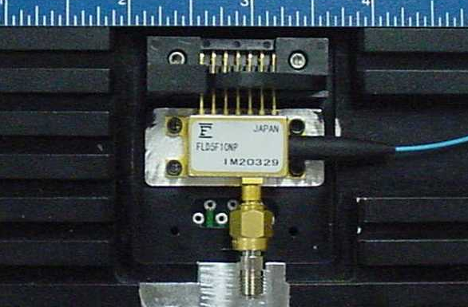
Approach #3: Integrated Laser/EA Modulator
Measured Signal and Distortion Characteristics vs. DC Bias Voltage
Optimum bias voltage
(2nd-order distortion
is minimized)
-20
f₁ = 5 GHz
-40
2f₁ = 10 GHz
(Photo removed)
Output Signal Magnitude (dBm)
-60
-80
3f₁ = 15 GHz
-100
Integrated Laser/EA Modulator
(Fujitsu FLD5F10NP)
-0.3
-0.5
-0.7
-0.9
-1.1
-1.3
DC Bias Voltage (V)
(Input signal: 0 dBm at f₁ = 5 GHz)
14

Slide 15
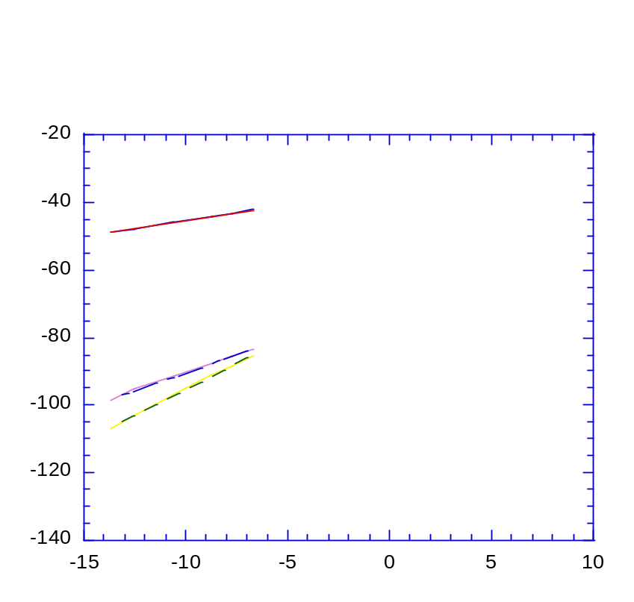
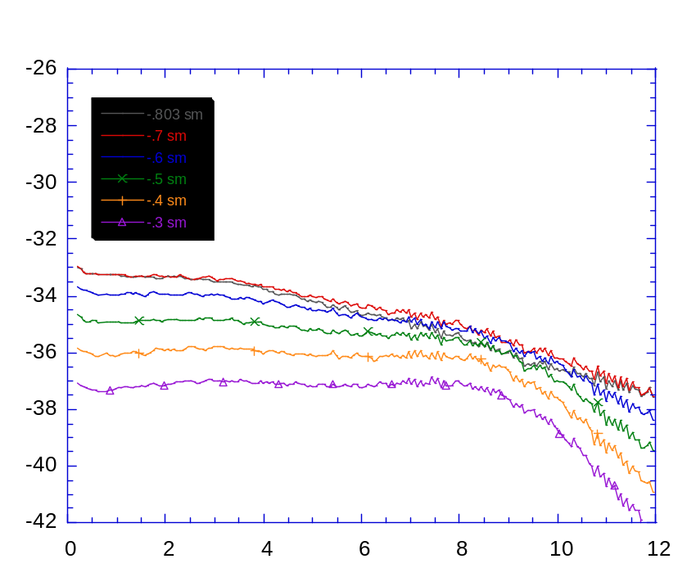
Approach #3: Integrated Laser/EA Modulator
Measured Performance w/1 km SM fiber and Discovery Photodetector
Measured Link Frequency Response vs. Modulator Bias Voltage
(Modulator biased for minimum 2nd-order distortion)
Measured Distortion Products
(Modulator biased for minimum 2nd-order distortion, detector bias = 6 V, fundamental frequencies ~ 5 GHz)
Fundamental frequencies
Link Gain (dB)
3 dB
Output Power (dBm)
2nd-order distortion
< 4 dB
3rd-order distortion
Frequency (GHz)
Input Power at Fundamental (dBm)
At bias for minimum 2nd-order distortion: G_{11 GHz} ~ – 37 dB
BW_{3dB} ~ 9.5 GHz
ΔG_{0.5-11 GHz} < 4 dB
NF ≤ 42 dB
SFDR₃ ≥ 95 dB·Hz^{2/3} ; SFDR₂ ≥ 79 dB·Hz^{1/2}
CDR ≥ 137 dB·Hz
15

Slide 16
Approach #4 : Directly Modulated DFB Approach #5: Directly Modulated VCSEL
These approaches do not seem feasible at this point
  The directly modulated DFB would have a worse NF than any of the external modulation links, because of the greater noise generated (larger RIN across 0.5-11 GHz range)
  An appropriate directly modulated VCSEL is not yet available
    High-bandwidth devices are at wavelengths that would not propagate reliably in 1 km of fiber
    High-bandwidth devices are not available in packaged form
16

Slide 17
Measured Performance* and Cost** of Three Candidate Link Approaches
Approach
#1 Separate CW Laser and
LiNbO₃ MZ Modulator
#2 Separate CW Laser
and EA Modulator
#3 Integrated CW Laser
and EA Modulator
G_{0.5 GHz}
(dB)
– 26.5
– 33.5
– 33.5
G_{11 GHz}
(dB)
– 32
– 36.5
– 37
NF *
(dB)
39
42
42
SFDR₃*
(dB·Hz^{2/3})
103
99
95
SFDR₂*
(dB·Hz^{1/2})
96
84
79
CDR *
(dB·Hz)
141
140
137
Cost**
($, 9/01)
4,508
3,608
2,945
Cost**
($, 4/02)
3,771
3,024
2,464
= Best of the three approaches for this attribute
= Worst of the three approaches for this attribute
Worst-case performance is quoted (this is usually at 11 GHz) at the modulator bias point where second-order distortion products are negligible.
Cost is for 1,000 links.
*
**
17

Slide 18
Recommendations and Caveats
Lithium niobate Mach-Zehnder modulator approach yields the best performance
  3 dB roll-off below 11 GHz can be addressed by pushing harder on the vendors (Codeon, JDSU, and their competition)
  This is the most expensive approach
Separate laser, EA modulator approach yields good performance at lower cost
  Flattest response of three approaches measured
  ~3 dB worse NF than lithium niobate MZ approach
  Cost could drop if SM-fiber pigtailed laser is found
  Caveat: separate temperature control needed for laser and modulator (whereas the integrated laser/EAM devices track each other across temperature, requiring only one control)
Integrated laser/EA modulator approach is lowest cost, but has the worst performance, most sensitive to bias voltage
  Is dynamic range performance acceptable?
  Fujitsu will sign up to a 3 dB BW of 11 GHz
This seems to be the most acceptable trade-off
18

